Slide 1
Neural Network and
Fuzzy Systems
CSE 0613-4221
Sakurah Ismail
Lecturer, Dept. of CSE NBIU

Slide 2
Artificial Neuron
Artificial neuron is nothing but a composite function, (𝒈 𝒇)(𝒙)
𝒖 = 𝒇(𝒙)
𝒚 = 𝒈(𝒖)
𝒙
𝒇(𝒙)
𝒈(𝒖)
𝒚
where
Artificial Neuron
𝒙 is input and 𝒚 is output
𝒇(𝒙) is a linear function
𝒈(𝒖) is generally a nonlinear function
3

Slide 3
Artificial Neuron
In an artificial neuron, at first input is multiplied by a weight and summed with bias.
𝒃
𝒚 = 𝒈(𝒇(𝒙))
𝒖 = 𝒇(𝒙) = 𝒘𝒙 + 𝒃
𝒙
𝒘
𝒇(𝒙)
𝒈(𝒖)
𝒚
where
Artificial Neuron
𝒘 is weight which decides how much influence 𝒙 will have on 𝒖.
𝒃 is bias which ensures that 𝒖 is not too big or too small on average
4

Slide 4
Artificial Neuron
𝒖 = 𝒇(𝒙)
= 𝒘₁ 𝒙₁ + 𝒘₂ 𝒙₂ + 𝒘₃ 𝒙₃ + 𝒃
= 𝒘^{T}𝒙 + 𝒃
𝒈(𝒖) is known as activation function. Generally nonlinear functions are used as activation functions.
𝒃
𝒙₁
𝒘₁
𝒘₂
𝒙
𝒇(𝒙)
𝒈(𝒖)
𝒚
2
𝒘
3
𝒙
3
Artificial Neuron
5

Slide 5
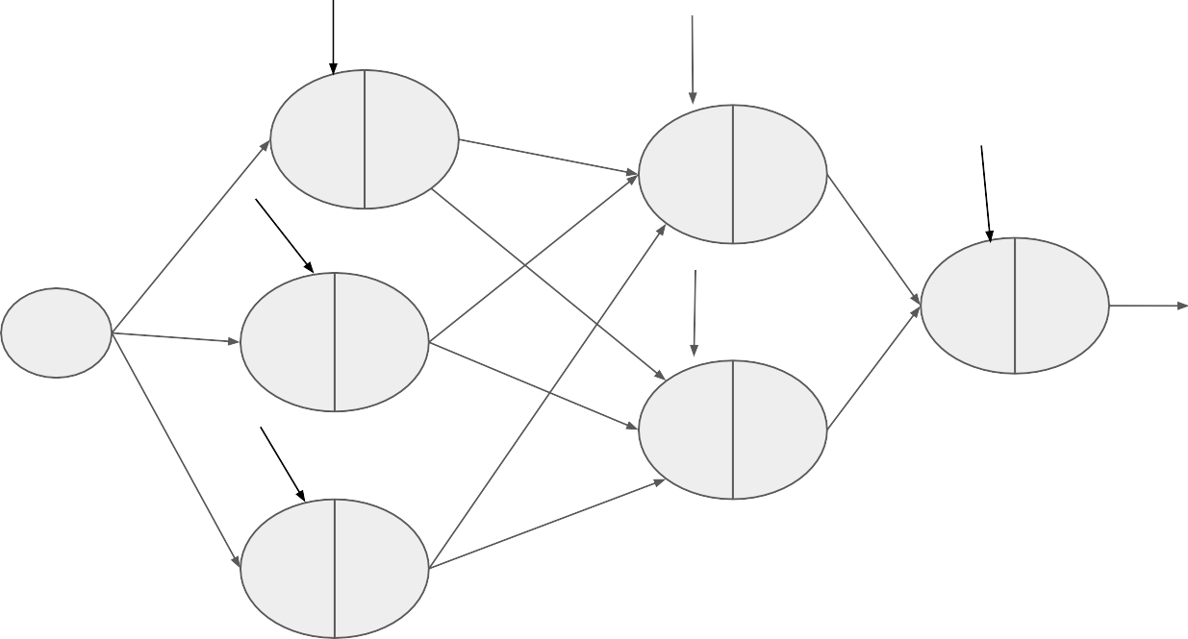
Artificial Neural Network (ANN)
ANN is nothing but a composite of composite functions:
(𝒈_{n}o 𝒇_{n…….}𝒈₂o 𝒇₂ o 𝒈₁o 𝒇₁)(𝒙)
𝒃₁
𝒃
𝒘
4
𝒇 𝒈
4
𝒃
𝒘₁
1
1
𝒘
𝒇 𝒈
6
5
4
4
𝒘
𝒃
𝒘
10
Number of parameters: weights + bias (optional) + any variables in 𝒈(.) (optional)
2
6
𝒙
𝒘₇
𝒃₅
𝒇₆ 𝒈₆
𝒚
𝒘₂
𝒇 𝒈
2
2
𝒘
𝒘
8
11
Input layer
𝒇 𝒈
Output layer
𝒃₃
5
5
𝒘
𝒘
3
9
𝒇₃ 𝒈₃
Hidden layer
Hidden layer
6

Slide 6
ANN
ANN is a machine learning algorithm that uses a network of interconnected artificial neurons to process data to imitate our human brain.
All ANNs have three kinds of layers:
One Input Layer: to receive data.
One or Multiple Hidden Layers: to process data
One Output layer: to produce the output.
Shallow NN is a type of ANN with a few hidden layers, usually one or two.
Deep NN (DNN) is a type of ANN having multiple hidden layers to solve complex problems.
GPT-3: 96 hidden layers
EfficientNet: 5-400 hidden layers
ResNet-152: 152 hidden layers

Slide 7
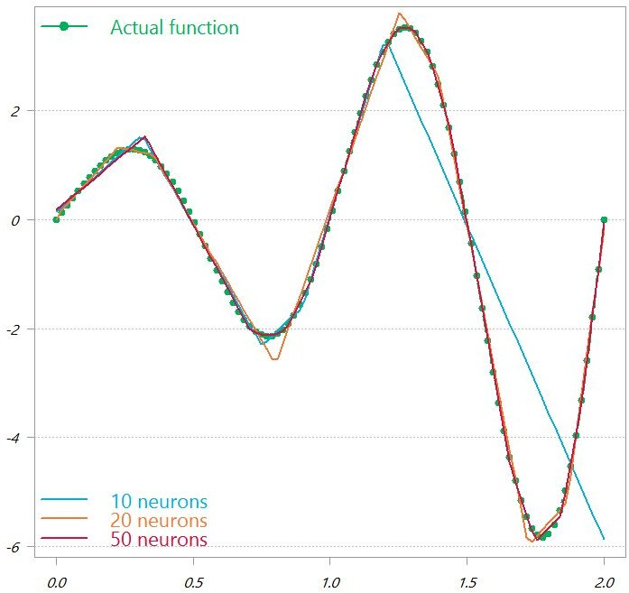
Universal Function Approximator
The main strong point of DNN is its universal approximation power.
An DNN can approximate any function no matter how complicated the function is if we can ensure that the network has sufficient number of neurons.
Image Source: Google Search Engine
8

Slide 8
Hidden Layers
The number of hidden layers in a DNN depends on the complexity of the data:
Linearly separable data: No hidden layers are needed
Less complex data: 1–2 hidden layers are sufficient
Large data: 3–5 hidden layers are recommended
Complex data: Additional layers can be helpful
Depth of an ANN = the number of hidden layers + the output layer
Sometimes a deeper network has better performance comparing to a shallower network
A DNN has risks of
experiencing vanishing gradient problem
high sensitivity to input data
having similar performance of a shallow network.

Slide 9
Hidden Layers
Increasing the number of hidden layers
Can increase the performance of the network.
Adding too many hidden layers
Can lead to overfitting, where the model memorizes the training data but doesn't generalize well to new data.
Reducing the number of hidden layers
Can directly impact the accuracy of the network. For complex problems, the network might not be trained properly with fewer hidden layers.
Optimal number of layers depends on several factors including:
the data
the optimizer, and
the network's architecture

Slide 10
Number of Neurons
Number of neurons in the:
input layer depends on the size of the input data
for 28x28 input image, 784 neurons in the input layer
output layer depends on the size of the output data
in a binary classifier, one or two neurons in the output layer
in a 10 class classifier, four or ten neurons in the output layer
hidden layers depends on us, i.e., who design the architecture of the NN
More neurons means:
more parameters for tuning
more time for tuning parameters
more data for avoiding overfitting
more hardware support, i.e., computational power & memory during parameter tuning, and storage space for saving model.

Slide 11
Parameter Vs Hyperparameter
Parameters: which NN will learn from data
𝒘, 𝒃, any variables in 𝒈(.)
Hyperparameters: which we need to decide based on our experience, intuition or error-trial such as
number of layers
number of neurons in each layer
activation function
epoch number
learning rate
12

Slide 12
Keep in Mind
Designing a suitable DNN automatically is not fully explored yet.
Recent Works: Neural Architecture Search—Finding the Best Model Design Automatically
Designing a suitable network architecture is still a error-and-trial process.
Not an architecture optimum for a data will be optimum for all datasets.
It is upto us what will be the number of hidden layers and number of neurons in each hidden layer. However, we need to be careful.
We should not design or work with any network which:
cannot be run in our available hardware support.
can be easily overfitted on our available training data.

Slide 13
Class Work
Design a simple Artificial Neural Network (ANN) that can recognize handwritten digits from 0 to 9.
Design a simple Artificial Neural Network (ANN) that can recognize handwritten digits from 0 to 9. Input Image (56x56)
What is overfitting ?
Why Generally nonlinear functions are used as activation functions.

